Slide 1
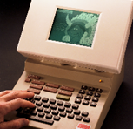
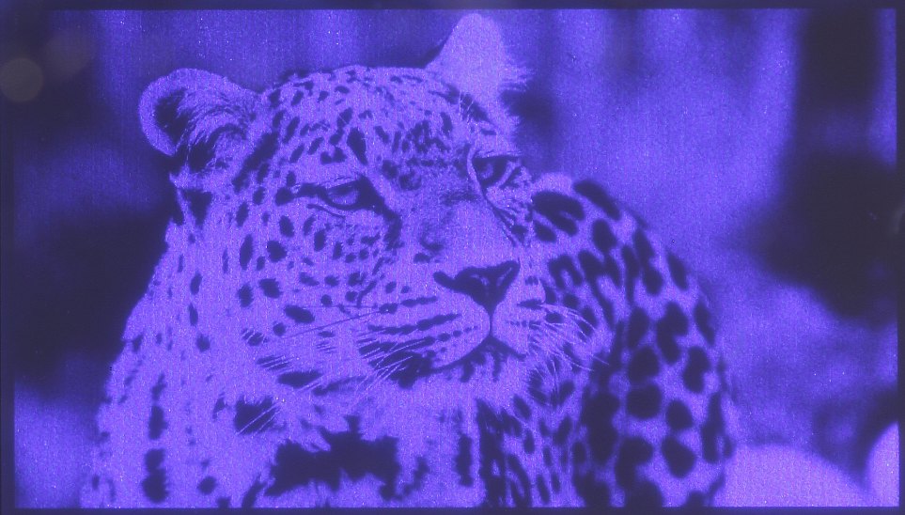
New generation of display for a smarter world

Slide 2
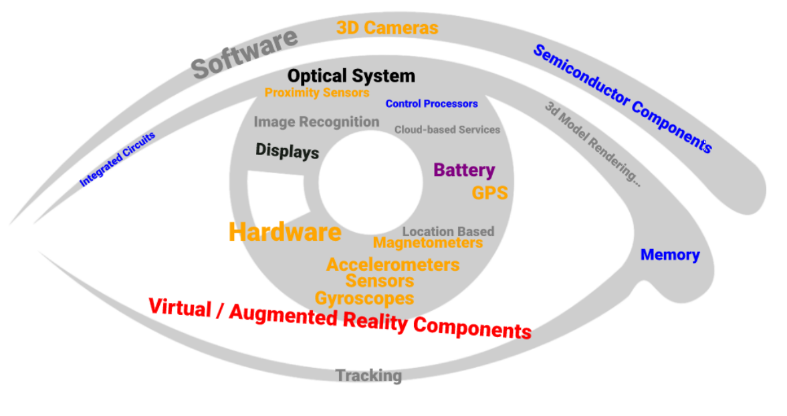
What is missing?
What are the remaining challenges?
User-friendly interfaces
Low power
Social rejection
Real time object classification
Field of View
Digital fatigue
Brightness
Resolution
size and weight
Use case
Immersive FoV
Road ahead is still long …

Slide 3
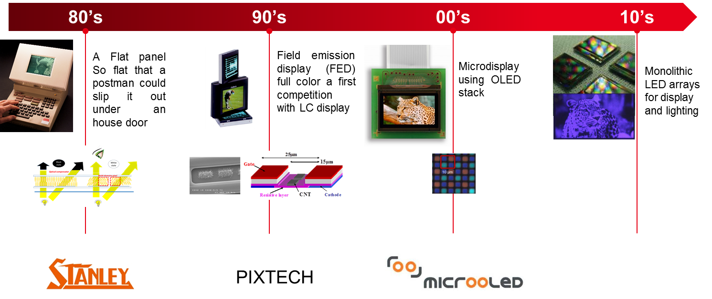
Keep on being pioneer in DISplay
success stories for 40 years
Next big thing on Micro LED

Slide 4
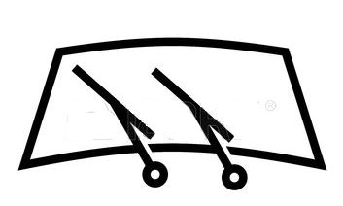


Leti’s fields
HMD
glasses
(VR/AR/MR)
HuD
From display to
Augmented Reality
(AR)
Micro-display technology
&
Optical system
Large display
and true light field
Leti’s value lies in our ability to have ongoing work on
components and optical system…

Slide 5
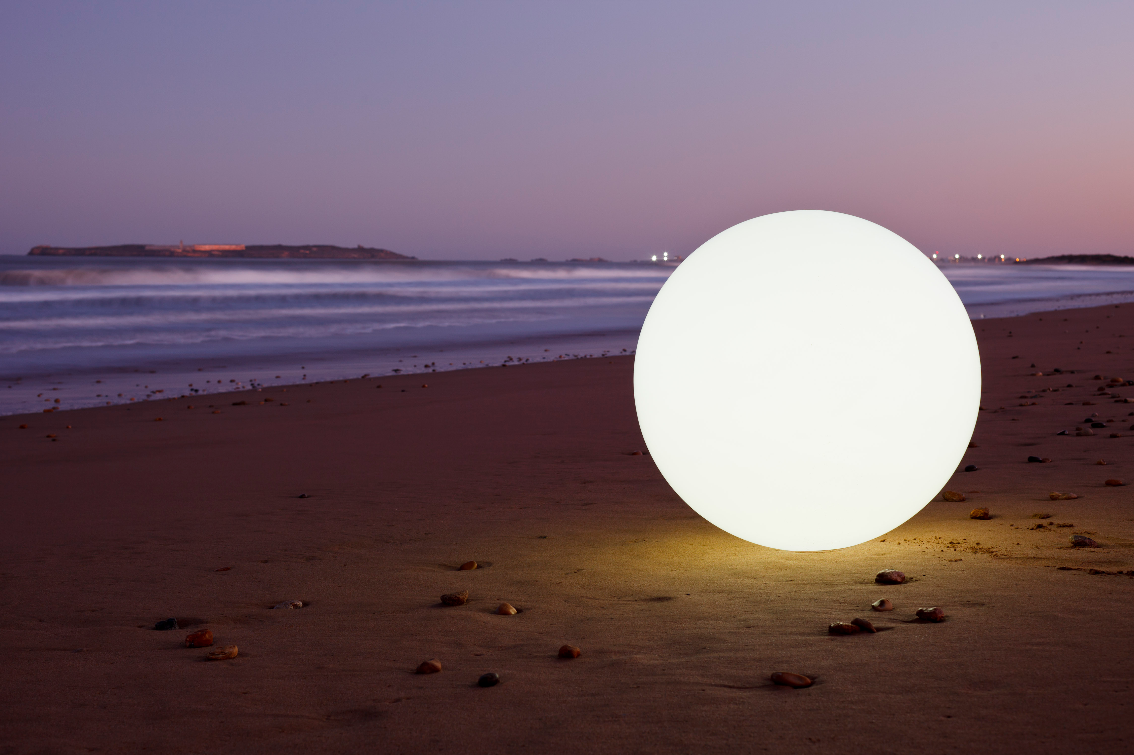
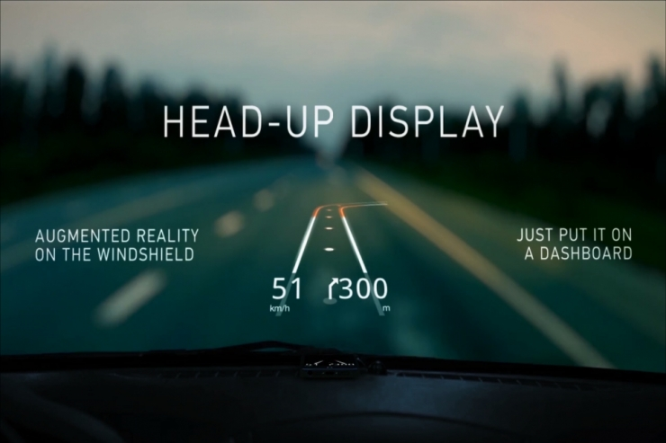

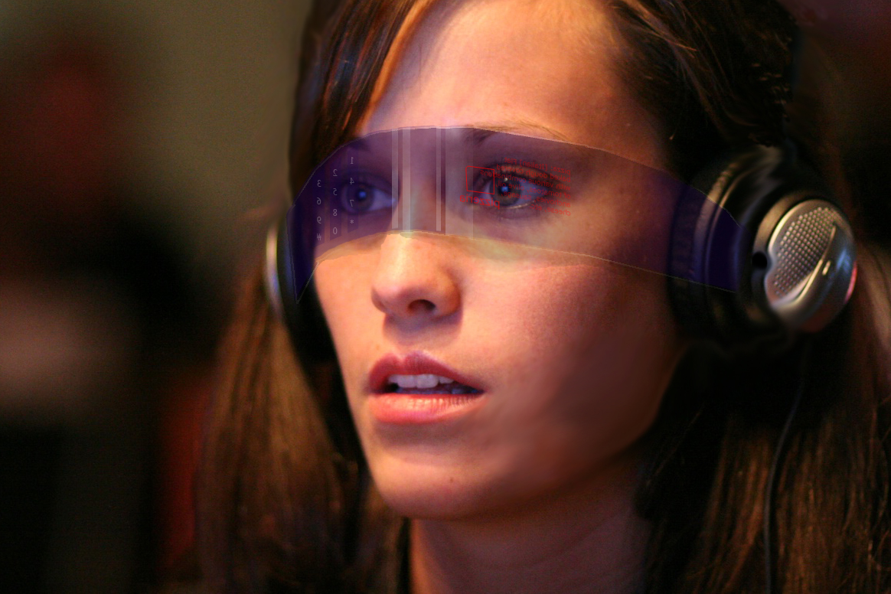


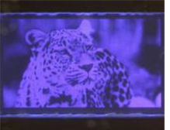
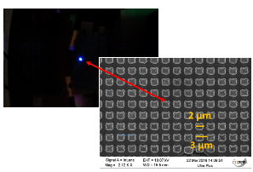
micro-led array Platform
Advances in Display Technologies VIII
High-resolution active-matrix 10-um pixel-pitch GaN LED microdisplays for augmented reality applications [10556-17]
1 February 2018 11:00 AM
Epitaxy on patterned substrates & native color
LED array process pixelization down to 3 µm
3D integration technique of LED arrays on CMOS
IC silicon active matrix for LED driving
QDs and nanophosphors
2D layers
Curved display to simplify the optics
Micro-LED
Key achievements in 2017
Microdisplay WXGA monochrome 10µm pitch
Microdisplay monochrome 3 µm pitch

Slide 6
What is inside ?
Epitaxy on patterned substrates & native color
LED array process pixelization down to less than 3 µm
3D integration technique of LED arrays on CMOS
IC silicon active matrix for LED driving
QDs and nanophosphors
2D layers
Curved display to simplify the optics
Led structure growth on various substrates
Self aligned patterning technology
Different hybridization technologies for different needs
ASIC design dedicated to microLED requirements
Color conversion implementation
Integrate optical system constraint on the display
Key
facts

Slide 7
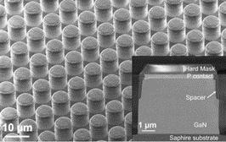
What is inside ?
Epitaxy on patterned substrates & native color
Led array process pixelization down to less than 3 µm
3D integration technique of LED arrays on CMOS
IC silicon active matrix for LED driving
QDs and nanophosphors
2D layers
Curved display to simplify the optics
Led structure growth on various substrates
Self aligned patterning technology
Different hybridization technologies for different needs
ASIC design dedicated to microLED requirements
Color conversion implementation
Integrate optical system constraint on the display
Key
facts

Slide 8
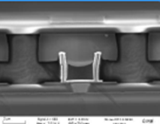
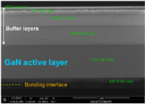
What is inside ?
Epitaxy on patterned substrates & native color
LED array process pixelization down to less than 3 µm
3D integration bonding of Led arrays on CMOS
Cu
SiO₂
IC silicon active matrix for LED driving
QDs and nanophosphors
2D layers
Curve display to simplify the optics
Led structure growth on various substrates
Self aligned patterning technology
Different hybridization technologies for different needs
ASIC design dedicated to microLED requirements
Color conversion implementation
Integrate optical system constraint on the display
Key
facts

Slide 9
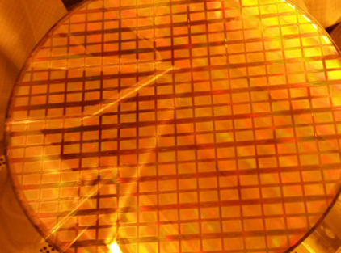
What is inside ?
Epitaxy on patterned substrates & native color
LED array process pixelization down to less than 3 µm
3D integration bonding of LED arrays on CMOS
IC silicon active matrix for Led driving
QDs and nanophosphors
2D layers
Curve display to simplify the optics
Led structure growth on various substrates
Self aligned patterning technology
Different hybridization technologies for different needs
ASIC design dedicated to microLED requirements
Color conversion implementation
Integrate optical system constraint on the display
Key
facts

Slide 10
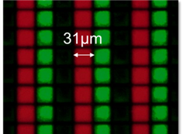
What is inside ?
Epitaxy on patterned substrates & native color
LED array process pixelization down to less than 3 µm
3D integration bonding of LED arrays on CMOS
IC silicon active matrix for LED driving
QDs and nanophosphores
2D layers
Curve display (xx°) to simplify the optics
Led structure growth on various substrates
Self aligned patterning technology
Different hybridization technologies for different needs
ASIC design dedicated to microLED requirements
Color conversion implementation
Integrate optical system constraint on the display
Key
facts

Slide 11
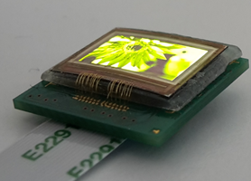
What is inside ?
Photonic Instrumentation Engineering V
Curved sensors for compact high-resolution wide field designs: prototype demonstration and optical characterization
1 February 2018 02:40 PM
Epitaxy on patterned substrates & native color
LED array process pixelization down to less than 3 µm
3D integration technique of LED arrays on CMOS
IC silicon active matrix for LED driving
QDs and nanophosphors
2D layers
Curve display (xx°) to simplify the optics
Led structure growth on various substrates
Self aligned patterning technology
Different hybridization technologies for different needs
ASIC design dedicated to microLED requirements
Color conversion implementation
Integrate optical system constraint on the display
Key
facts

Slide 12
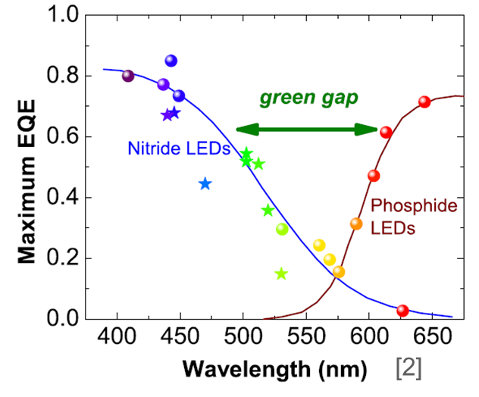
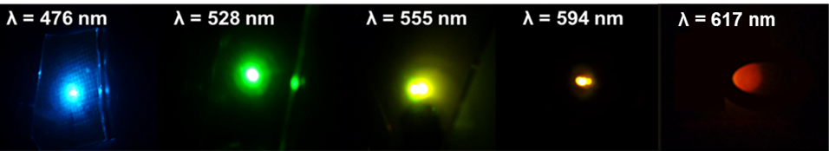
native color solution
What are the obstacles?
Soitec Smart cutTM technology
Light-Emitting Diodes: Materials, Devices, and Applications for Solid State Lighting XXII
30 January 2018 11h40 am
Strained InGaN layer (~200 nm)
Transferred relaxed InGaN layer (~100 nm)
Burried Oxyde
(~600 nm)
GaN template
Sapphire substrate
Donor
InGaNOS substrate
First
Results
IQE of 31% @ 536 nm, 17% @566nm, 10% @ 598 nm and 2,7% @ 617 nm
Next steps light extraction and towards smaller mesa as small as 10µm pitch for micro-LED

Slide 13

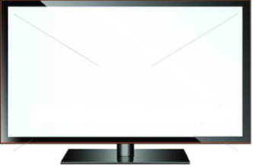
From Microdisplay to large display: What’s new ?
Could Micro-LED challenge LCD or OLED?
Majors are driving and maturing the market : Sony, Samsung, Apple, ….
Still many challenges to get an industrial solution …
❶ microLED with its CMOS
Leti’s novel
proposal*
Micro-Led wafer with driving electronic
❷ Transfer & assembly
A modular solution with no need of TFT backplane
*Patented solution

Slide 14
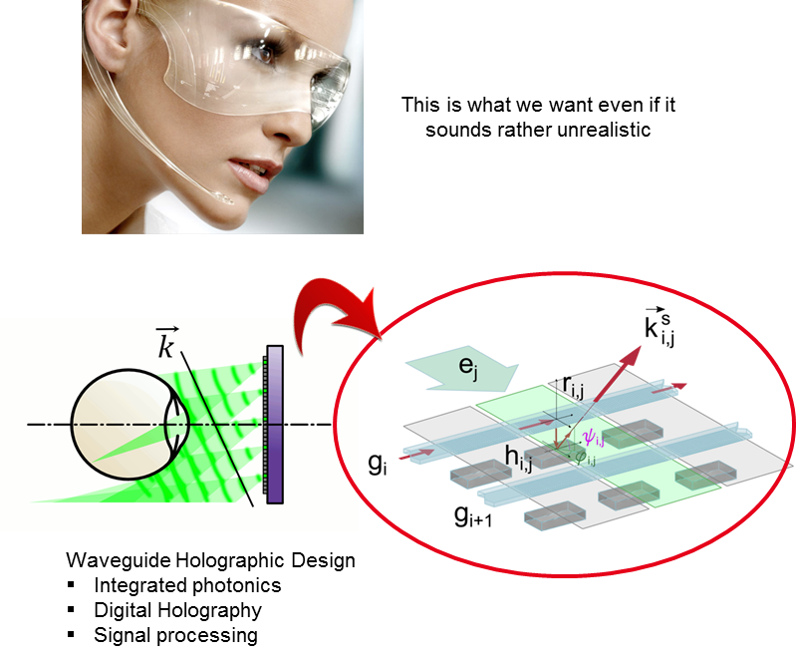
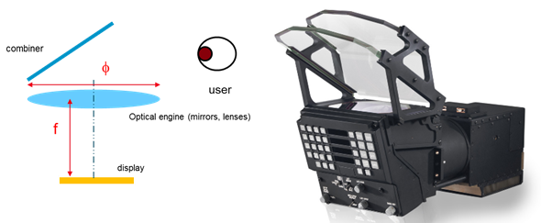
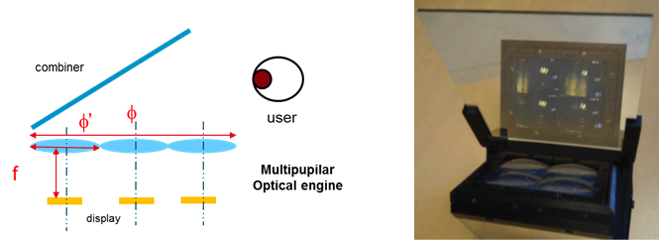
and on optical systems …
Towards non-conventional, lens-free, see-through glasses
Light field : multi views approach
High resolution displays
Micro Lens Arrays
Optical design
Computational imaging
Calibration
HMD
HuD
Light field
A bio-inspired / multi-channel approach
Single lens system
Leti’s solution
A large scope of technologies to meet market challenges …

Slide 15
Takeaway
Team up with Leti and get value with optical devices
Nomadic information bringing innovation and new market opportunity for display.
The available products and concepts are still at their infancy and a number of challenges are yet to be addressed
brightness, resolution, full color combined with large field of view, power consumption, system compactness and user interaction.
Leti’s mission: To develop new better products with industrial partners on challenging topics
Large field of view displays and systems for augmented reality
Efficient native color microdisplay
Simplified, low cost Large display
If you share our vision and want to take on challenges with us …
Please contact-us!

Slide 16

Meet Leti experts at Booth #431 French Pavilion
South Hall
Sylvie Joly
Display Business Developer, Optics and Photonics Division
 Sylvie-j.joly@cea.fr
 +33 6 45 15 02 98

